Slide 1
CUSTOMER RETENTION
BY: ARPITA MISHRA

Slide 2
Introduction
E-commerce (electronic commerce) is the activity of electronically buying or selling of products on online services or over the Internet.
It draws on technologies such as mobile commerce, electronic funds transfer, supply chain management, Internet marketing, online transaction processing, electronic data interchange (EDI), inventory management systems, and automated data collection systems.
The ecommerce industry was reported at $24 billion in 2017 and was recognized as the fastest growing industry in India.
The ecommerce market grew to $38.5 billion in 2018. It is estimated that one in every three Indian shops via smartphone and online retailers deliver to 20,000 pin-codes out of the 100,000 pin-codes in India
Technology enabled innovations like digital payments, hyper-local logistics, analytics driven customer engagement and digital advertisements will likely support the growth in the sector.

Slide 3
The Indian E-commerce market is expected to grow to US$ 200 billion by 2026 .
Much of the growth for the industry has been triggered by an increase in internet and smartphone penetration.
Five major factors that contributed to the success of an e-commerce store have been identified as: service quality, system quality, information quality, trust and net benefit
Customer satisfaction has emerged as one of the most important factors that guarantee the success of online store; it has been posited as a key stimulant of purchase, repurchase intentions and customer loyalty.
Present data is collected from the Indian online shoppers.
Our aim is to analyse the data for further studies.

Slide 4
Exploratory Data Analysis
The dataset was in the form of excel file.
All the necessary libraries like Pandas, numpy and matplot lib were imported.
The data set was loaded as df by using pd.read_excel.
The shape of the dataset was found to be 269 rows and 71 columns.
The columns included the customers age, gender, opinion about their online shopping, features important to online shopping and their preference for online retailers.
The datatypes of all the feature were observed by
df.dtypes.
The top five rows with all the columns were displayed by df.head().
Pin code column was dropped as we found it irrelevant for data analysis
df.drop(['pincode'],axis=1, inplace=True)

Slide 5
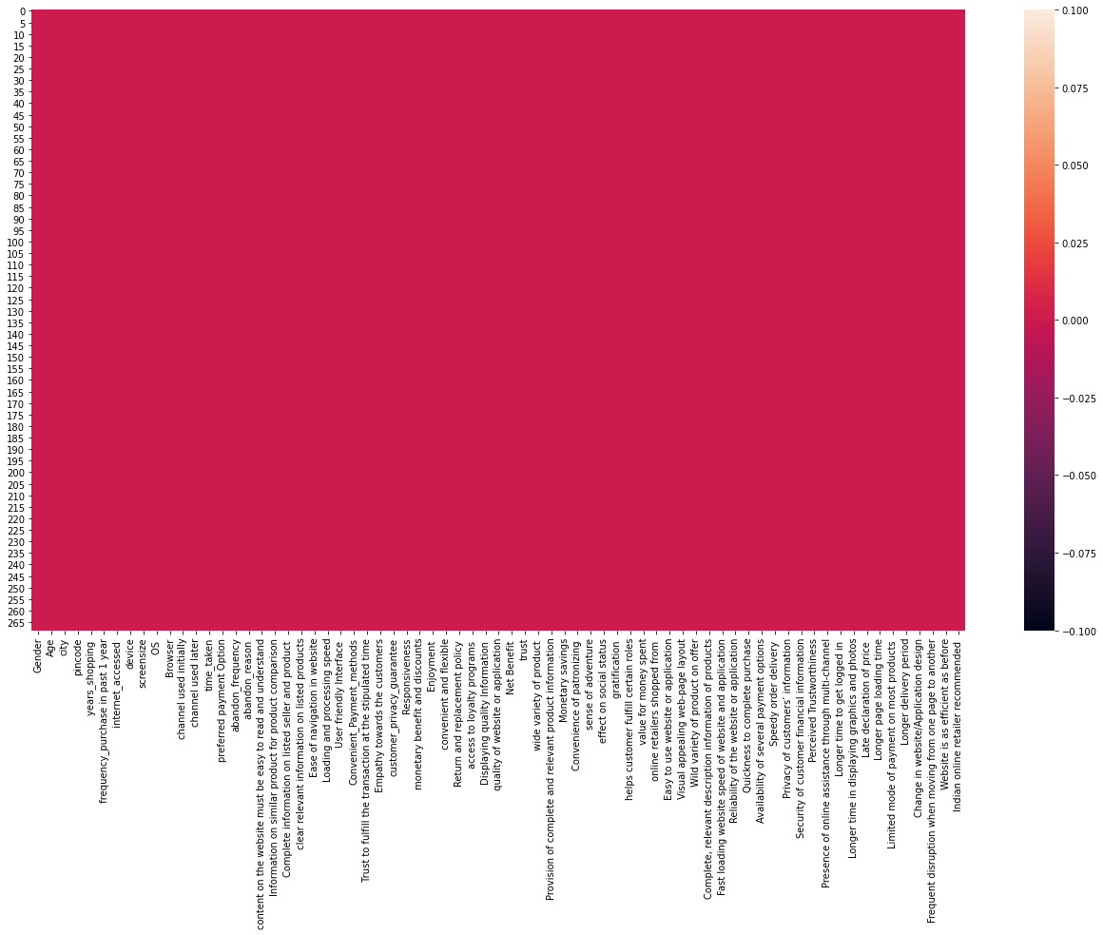
Null values in the dataset were observed by
df.isnull().sum()
To visualize the null values easily, heat map was used.
plt.figure(figsize=[22,12])
sns.heatmap(df.isnull())
plt.show
No null values were observed

Slide 6
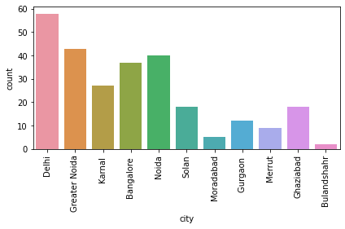
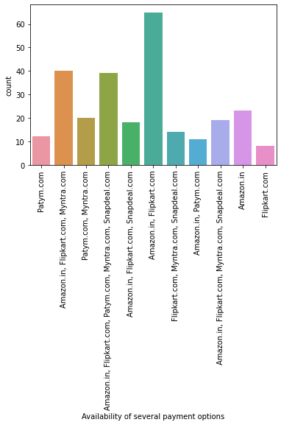
Univariate analysis
269 customers were asked about their details of online shopping. 71 questions were asked which was used as feature for data analysis on customer retention.
Countplot showed that most of the customers were from Delhi/NCR region, followed by Bangalore.

Slide 7
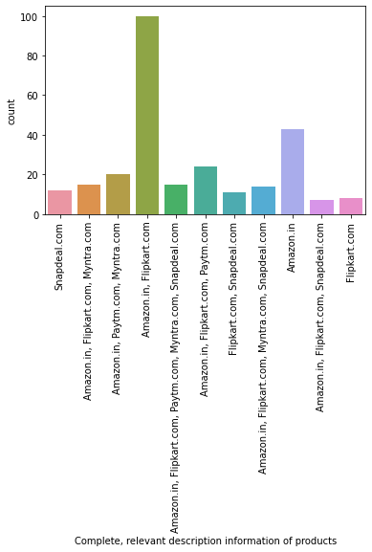
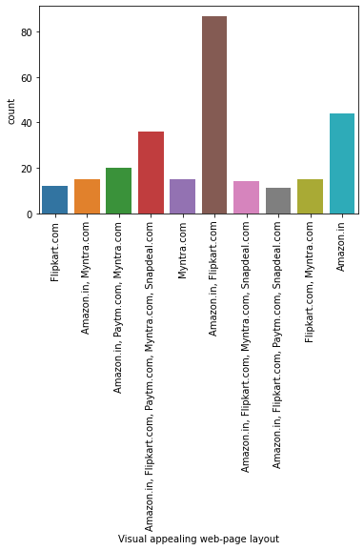
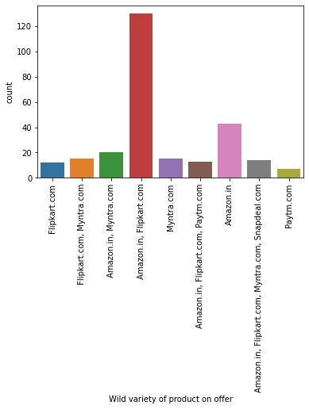
Majority of the customer found Amazon and Flipkart to be having complete relevant description of products, better visual appealing and wider product range with offers.

Slide 8
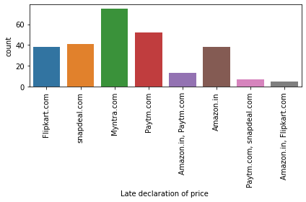
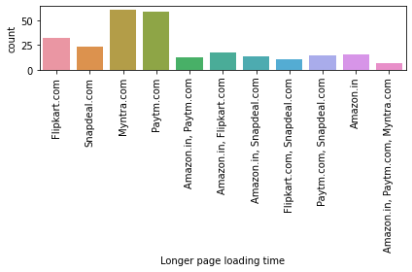
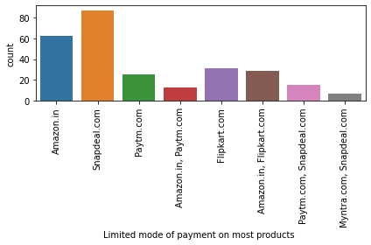
Myntra was found to have the late declaration of price and longer page loading time by majority of the customer.
Snapdeal had a limited payment option among all the retailers.

Slide 9
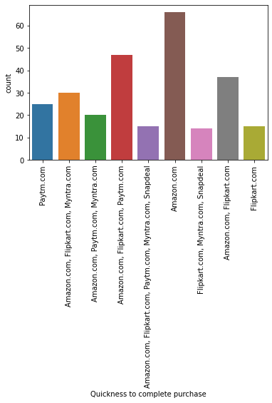
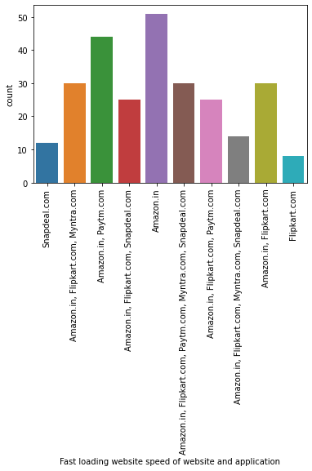
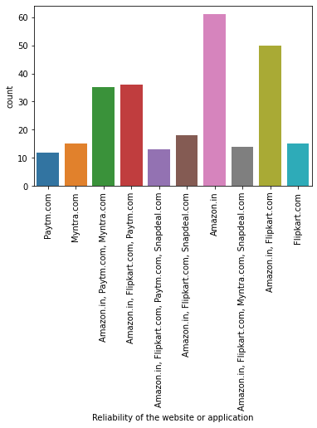
Amazon has been found to have fast website loading speed, more reliable and more quick in purchase

Slide 10
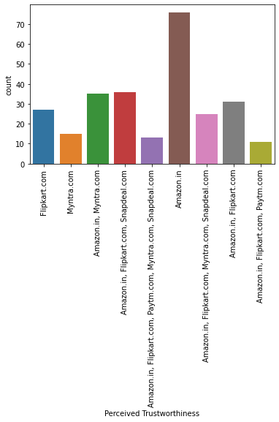
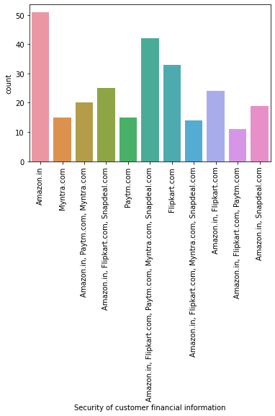
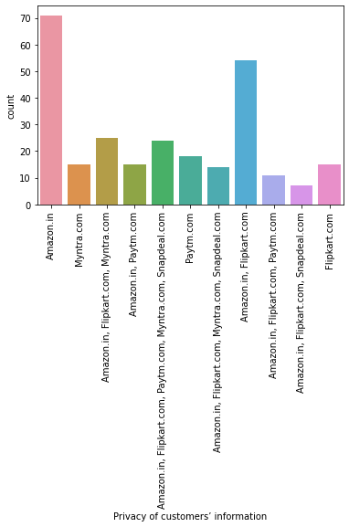
Amazon was rated the best in terms of security of financial information, customer privacy and eventually trust.

Slide 11
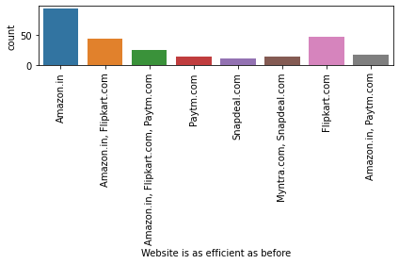
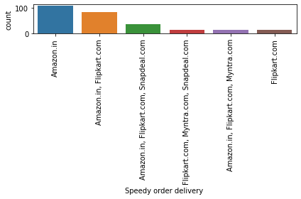
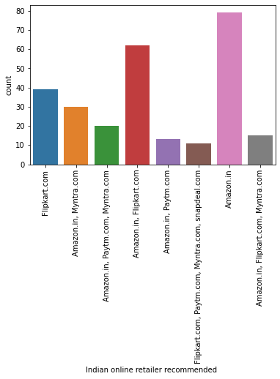
Customers found Amazon’s website efficient, and had the fastest product delivery.
Among all the Indian Online retailer Amazon was the most widely recommended one.

Slide 12
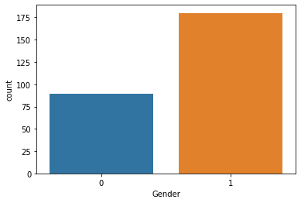
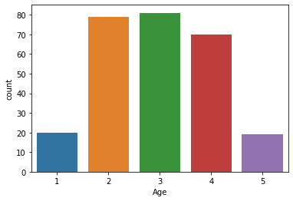
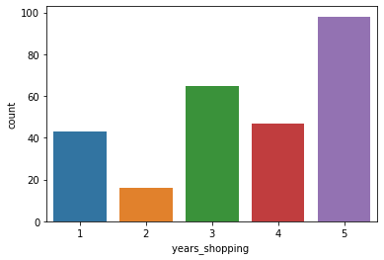
Univariate analysis
Present dataset shows that the strength of female was double to that of males.
Also most of the customer were in the age group between 20-50 years. Percentage of customers with age less than 20 and more than 50 were very less.
The customers have been shopping from past 5 years.

Slide 13
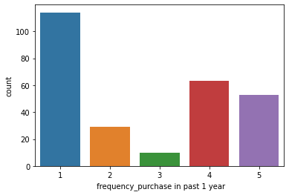
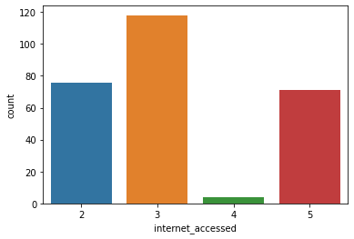
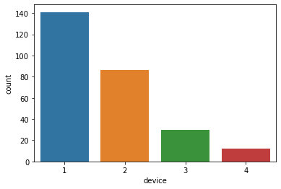
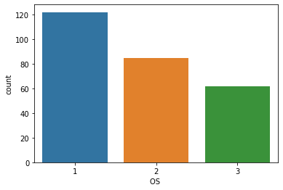
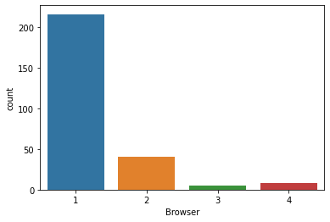
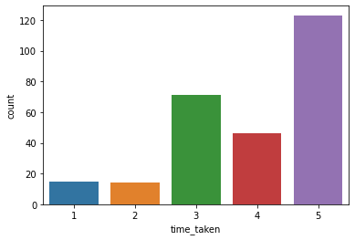
For majority of the customer, the frequency of shopping was less than 10 times in the last one year and take more than 15 mins to buy a product. The customers have been using mobile internet for shopping.The device used for shopping was found to be smartphones, followed by laptops. 3.Windows/windows mobile is being used as OS with google chrome as a browser.

Slide 14
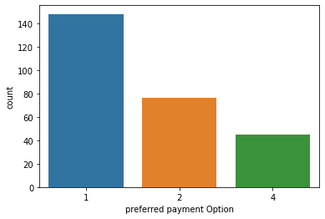
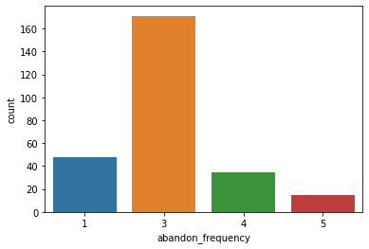
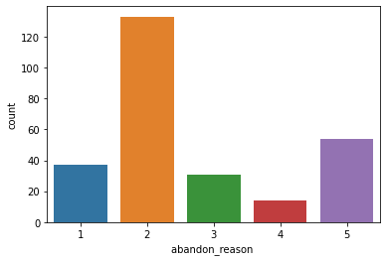
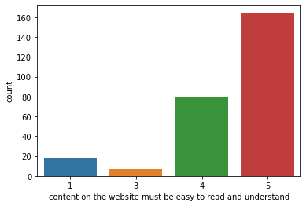
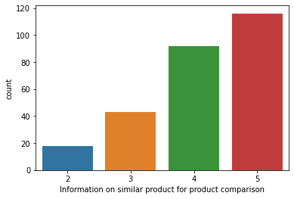
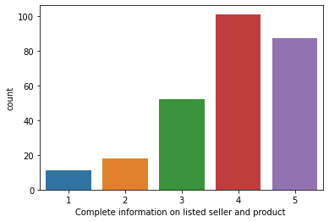
Most of the customer are using debit/credit cards for payment, followed by COD and e-wallet being used the least. Most common reason for leaving the cart without shopping is when better alternate offer is found on some other site. The content must be clear and understandable. Also the information of similar product for product comparison is also very important.

Slide 15
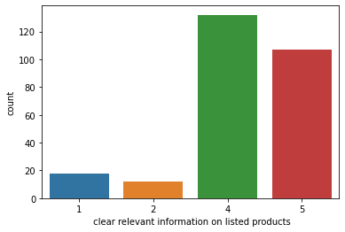
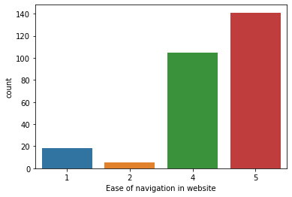
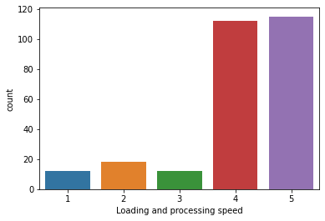
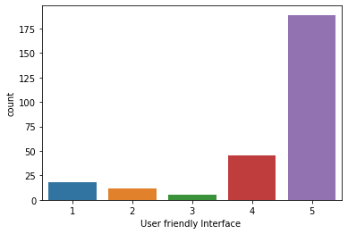
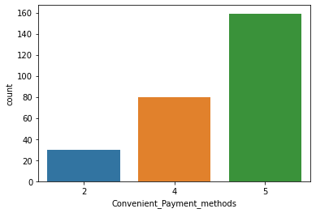
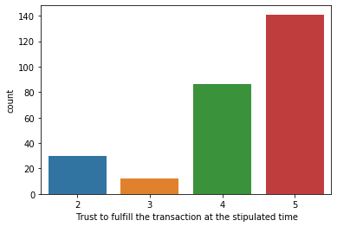
Clarity in product information, Ease of navigation in website,along with loading and processing speed is very crucial for customers. User friendly interface is another important feature to be taken into consideration

Slide 16
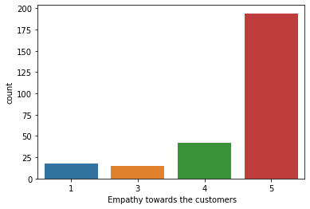
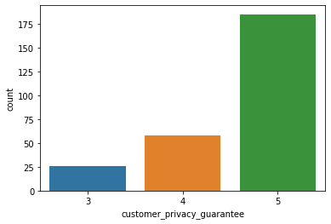
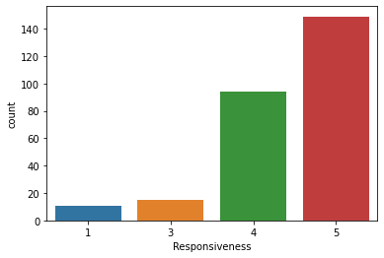
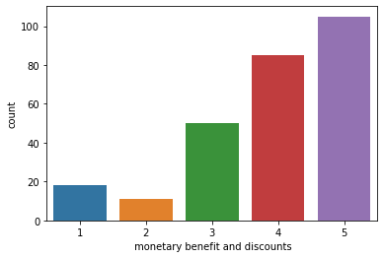
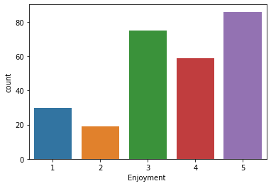
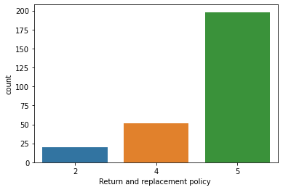
Customer care facility,solving queries,privacy and responsiveness are another important features important for customers.
Monetary benefit, return/replacement policy, has been found to be strongly preferred.

Slide 17
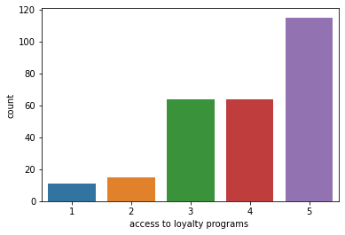
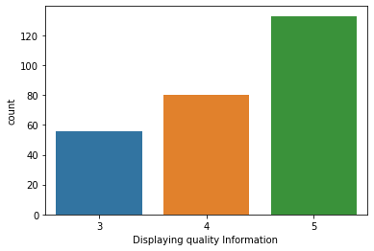
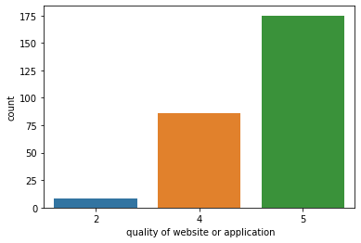
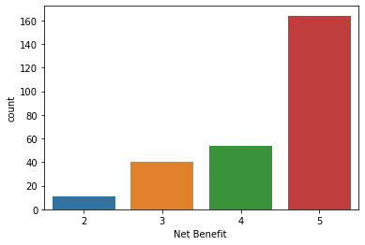
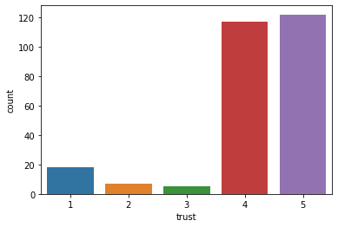

Access to loyalty program, wide variety of product, net benefit and quality of website or application has been the most strongly agreed factors.

Slide 18



The retailer must provide monetary benefit and it should have value for money

Slide 19



Bivariate Analysis
Although the preferred payment option has been found to be Debit/credit card but COD have been more preferred by females.
The frequency of abandoning a cart is greater in females than males.
Majority of the customer doing online shopping are between age group 20-50.There are very less customers below 20 years and more than 50 years in both males and females but the ratio of males to females in above 50 age group is less as compared to below 20 age group.

Slide 20


Most of the people shop via smartphones followed by laptops.The ratio of males to females is almost equal in using Desktop.Females have not been found using tablet.
Time taken to purchase a product is greater in females(more than 15 mins)as compared to males.Also males generally take 6-10 mins to purchase a product

Slide 21


Relationship between retailer recommended and (a)Gratification (b) Return and replacement policy using ‘Groupby’
Of all the retailer recommended Amazon has been considered to be associated with gratification by majority of the customer
Amazon has the best return and replacement policy and is the most recommended indian online retailer.

Slide 22

Correlation
plt.figure(figsize=[22,12])
sns.heatmap(cor,annot=True)
plt.title('correlation matrix')
plt.show

Slide 23
Correlation contd…..
A strong and obvious positive correlation was found between customer trust and retailer's empathy towards customer. Trust will be built in response of retailers response to queries.
There is strong correlation between monetary benefit and enjoyment which is quite understandable.
Also customers enjoy more with ease of navigation, faster loading and processing speed and user friendly interface.
Majority of the customer strongly agreed on the importance of display of content on the website. The content must be easy to read and understand.
Also, Information on similar product for product comparison, Complete information on listed seller and product, clear relevant information on listed products plays important role.

Slide 24
Summary
Delhi/NCR region has the maximum number of online customer
There ratio of male to female customers was 1:2 ie there were more female customers than males.
Also it was found that there were very few customers of age below 20 years and age more than 50 years.
Most of the customers in the dataset have been shopping since past four years or more.
However for majority of the customer, the frequency of shopping was less than 10 times in the last one year and take more than 15 mins to buy a product.
Most of the customers have been using mobile internet for shopping.
The device used for shopping was found to be smartphones, followed by laptops.
Windows/windows mobile is being used as OS with google chrome as a browser.
Most of the customer are using debit/credit cards for payment, followed by COD and e-wallet being used the least.
Most common reason for leaving the cart without shopping is when better alternate offer is found on some other site.

Slide 25
Following interpretation could be made from the graphical analysis of several questions answered by the customer
The content of the product must be clear and understandable.
Also the information of similar product for product comparison is also very important.
Ease of navigation in website, along with loading and processing speed is very crucial for customers.
User friendly interface is another important feature to be taken into consideration
Customer care facility, solving queries, privacy and responsiveness are another important features important for customers.
Monetary benefit, return/replacement policy, access to loyalty program, wide variety of product has been found to be strongly preferred.

Slide 26
Customer found myntra and flipkart to be having least visual appealing of web page lay out.
Majority of the customer found Amazon and Flipkart to be having wide variety of product on offer, complete, relevant description of information.
Late declaration of price and longer page loading time has been observed in Myntra and Paytm by majority of the customer.
Snapdeal has the longest delivery time.
Amazon has the most speedy order delivery
Amazon has the fastest loading speed and the purchase is also quick.
Customer privacy, security of financial information and trustworthiness is also found to be highest with Amazon retailer.
Most of the customer believe that Amazon is as efficient as before.
Amazon has been the most recommended website for online shopping.

Slide 27
Conclusion
Present data analysis indicates the critical factors in customer satisfaction.
It was found that features like monetary benefit, wide variety of product, user friendly interface, customer privacy and responsiveness are crucial for customer satisfaction.
Present data analysis can be exploited for further expansion of e commerce market in India.

